Slide 1


Bio-based Industries Joint Undertaking
Polyvios HADJIYIANGOU
Call Coordinator/Project Manager
Dublin Information Day
6 June 2017

Slide 2
Table of contents
Bio-based Industries Joint Undertaking
  Mission and objectives
  Implementation (AWP 2017)
  Statistics (IE case)
Evaluation process and evaluation criteria
How to participate

Slide 3
Table of contents
Bio-based Industries Joint Undertaking
  Mission and objectives
  Implementation (AWP 2017)
  Statistics (IE case)
Evaluation process and evaluation criteria
How to participate

Slide 4
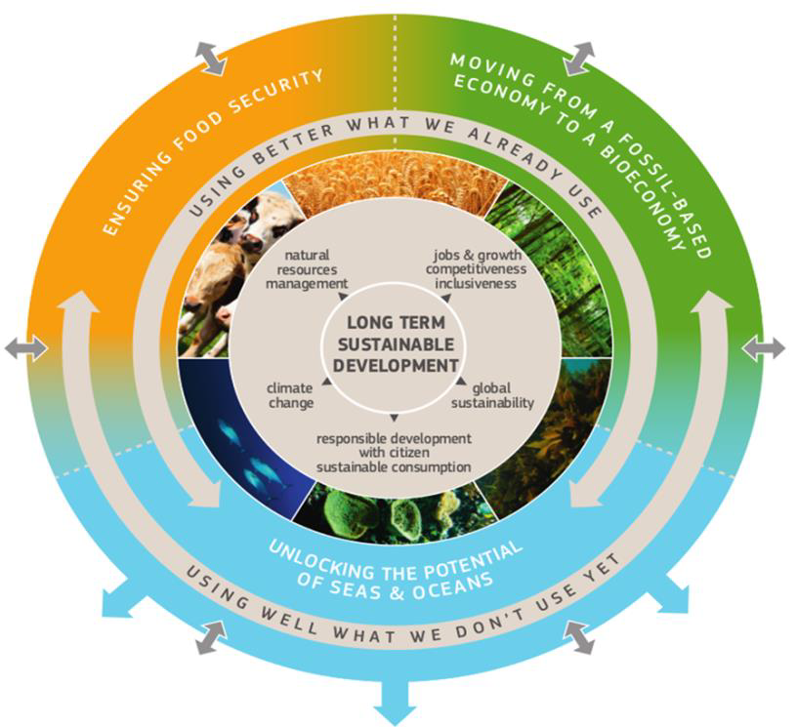

The bioeconomy
Encompasses those parts of the economy that use renewable biological resources from land to sear to produce food, bio-materials, bio-energy and bio-products EU Bioeconomy strategy 2012
BIO BASED Industry

Slide 5
BBI JU was needed to :
Pool resources from public & private sectors, to create a common platform;
Have joint approach, across sectors & geographies;
Offer joint financial commitment and a jointly defined programme;
Leverage additional investments;
Implement clear framework that brings clarity for activities & investments;
Ensure long term stability and predictability

Slide 6
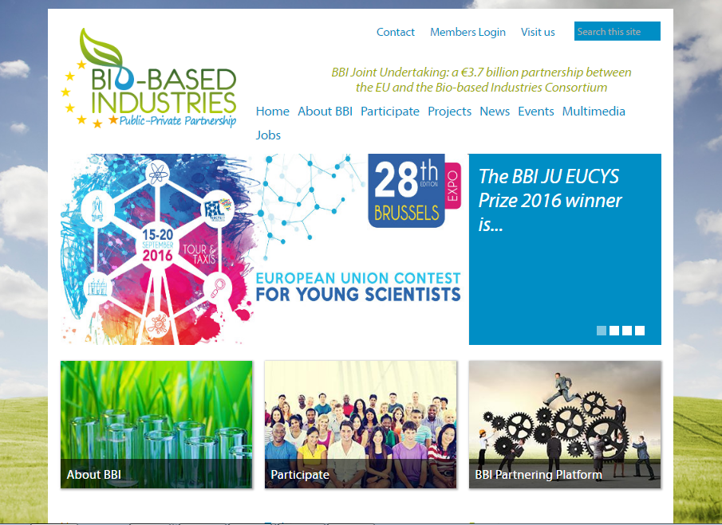


BBI Joint Undertaking (BBI JU)
Public-Private Partnership (PPP) developing sustainable and competitive bio-based industries in Europe
Partners:
  European Union (via EC)
  Bio-based Industries Consortium (BIC)
www.bbi-europe.eu

Slide 7
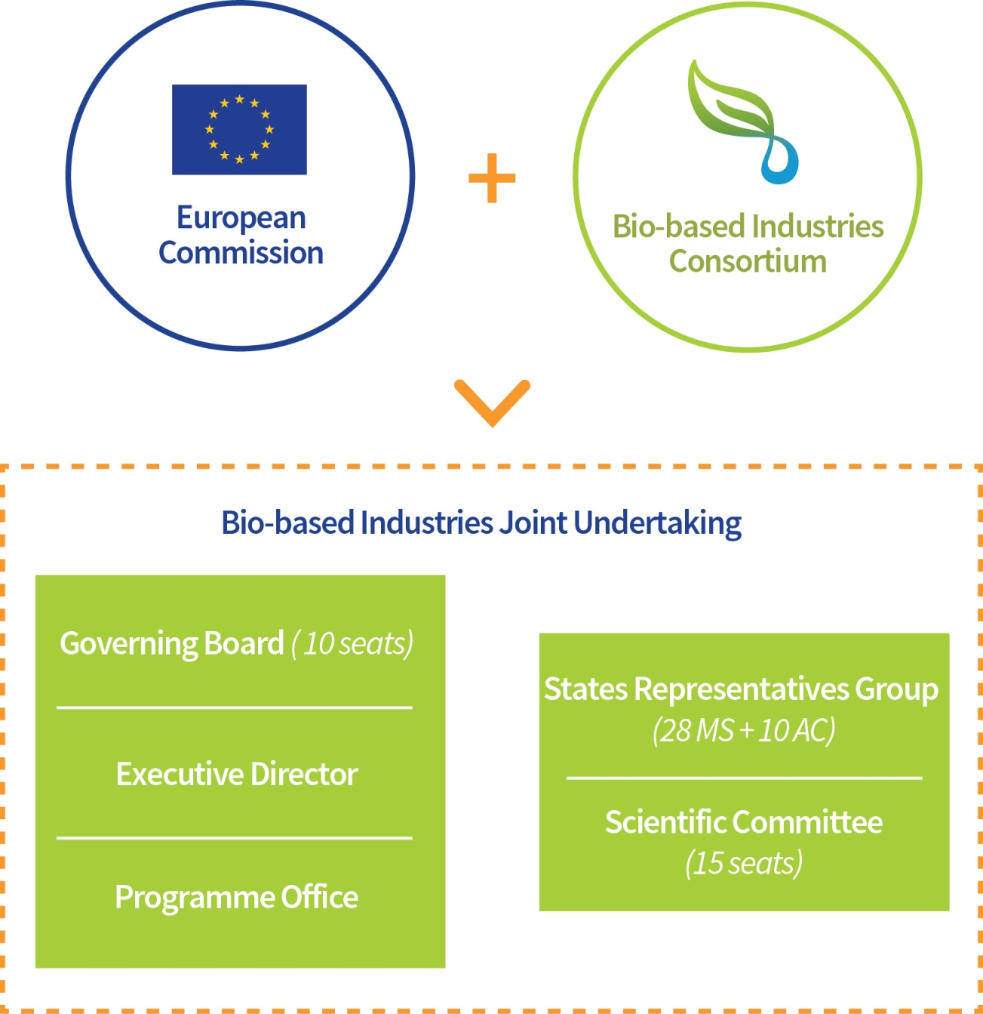
BBI JU - Governance
Public partner
26% (€ 975m) of investment
€3.7 billion
Private partner
74% (€ 2.730b)
of investment
Execute strategy
Implement SIRA
Advise on AWP
Support BBI actions

Slide 8
BBI JU mission
Implement, under Horizon 2020 rules, the Strategic Innovation and Research Agenda (SIRA) developed by the European Bio-based industry (BIC).
BBI JU Programme office team is in charge of :
Coordination of Annual Work Plan building
Call management
Proposals evaluation (by independent expert panel)
Grant Agreement Preparation Process
Whole project management life cycle
Communication, dissemination & stakeholder management
BBIJU operates under Horizon 2020 rules for participation Principles of openness, transparency and excellence

Slide 9

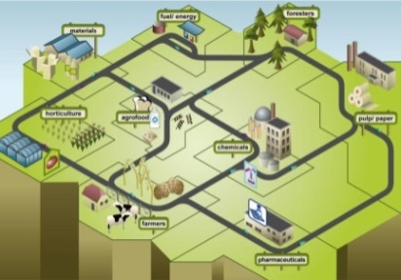
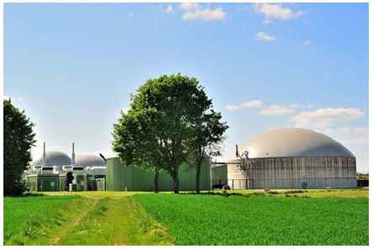
BBI’s objectives
Developing sustainable and competitive bio-based industries in Europe, based on advanced biorefineries that source their biomass sustainably by:
Demonstrating new technologies to fill the gap in value chains
Developing business models integrating all economic actors along the value chain
Set-up flagship biorefinery plants deploying business models & technologies to keep investment in EU
COUNCIL REGULATION (EU) No 560/2014
of 6 May 2014 establishing the BBI JU

Slide 10
Table of contents
Bio-based Industries Joint Undertaking
  Mission and objectives
  Implementation (AWP 2017)
  Statistics (IE case)
Evaluation process and evaluation criteria
How to participate?

Slide 11
BBI JU Calls overview
Annual Work Plan 2017
Call 2014
Call 2015
Call 2016
Call 2017
Call 2018
Call 2019
Call
2020
1
2
3
4
5
6
7
BBI JU achievements
  Call 2014: 10 running projects: 1 Flagship, 2 Demo, 7 RIAs
  Call 2015.1: 3 Flagship projects
  Call 2015.2: 23 running projects: (11 RIA, 9 Demo, 3 CSA)
  → 36 running projects + 29 from Call 2016 (GAP) = 65 projects
Notes:
Call 2016 is the third Call in a total of seven calls, which we plan for the period between 2014 and 2020.
Main drivers, which influenced the design of the Call 2016:
SIRA as a guiding document for the Call design
Changes in the operational environment of BBI: eg
- Political changes: The call should incorporate the concepts of current realities like the circular economy and the decarbonisation of the economy;
- Markets developments: there is an ongoing debate on BB products vs. fossil-based (FB) products: “it’s all about new and better functionalities”.
- New actors are becoming interested in the BB sector: it is important to attract new applicants and broaden bio-based applications.

Slide 12
Call 2017 – budget (lines)
Competition within each budget line
hearings for all Flagship proposals
Action | # topics | Budget (line)
CSA | 2 | € 2 million
RIA | 7 | € 36 million
IA-DEMO | 5 | € 22 million
IA-Flagship⁽¹⁾ | 2 | € 21 million
Total | 16 | € 81 million
In addition substantial resources from industry expected estimated value of the in kind contributions: >40 M €

Slide 13





Strategic orientation
- 4 pilars of value chains -
Strategy
Fostering a sustainable biomass feedstock supply to feed both existing and new value chains
Fostering a sustainable biomass feedstock supply to feed both existing and new value chains
expand & diversify the biomass feedstock portfolio
R1, D1, D2
FEEDSTOCK
Optimising efficient processing for integrated biorefineries
improve efficiency & sustainability, develop new processes
R2, R3, F1
Optimising efficient processing for integrated biorefineries
PROCESS
Developing innovative bio-based products for specific market applications
Developing innovative bio-based products for specific market applications
increase applicability, avoid price competition with fossil-based products
R4, R5, R6, R7, D3,
D4, D5, F2
PRODUCTS
Create and accelerate the market uptake of bio-based products and applications
respond to the concerns of society about BB products
S1, S2
Create and accelerate the market uptake of bio-based products and applications
MARKET
UPTAKE

Slide 14

Call 2017
Indicative Timetable
Call launch:
→ Open for proposals: from 11 April 2017
Submission of proposals:
→ Call closure: 7 September 2017 (17:00 CET)
Information on the outcome of the evaluation process:
max 5 months after the proposal submission deadline
→ By: 7 Feb 2018 (tentative December 2017)
Signature of grant agreements:
max 8 months after the proposal submission deadline
→ By: 7 May 2018
BACK
For more information (topics, timing FAQs ) go to BBI JU website and see i.e. BBI JU AWP & Call 2017 FAQ
Notes:
Messages:
The call has been opened two days ago:
However the topics where already published on BBI JU website in Dec 2015 (recall: minor changes since that time: addition of new Flagship topic)
more than 4 month time for the proposals submission till 8th Sept.

Slide 15
BBI JU ‘Actions’
Action | TRL ⁽³⁾ | Duration | BBI JU funding %
CSA | n/a | 1-3y | 100%⁽¹⁾
RIA | 3-5 | Up to 4y
IA-DEMO | 6-7 | 4-5y | 70%⁽²⁾
IA-Flagship | 8
(1) However: de facto no (0%) BBI JU funding for large enterprises
(2) Non-profit beneficiaries / linked third parties may be reimbursed at 100%
(3) TRL = Technology Readiness Level (value 1-9; higher TRL = closer to market)

Slide 16
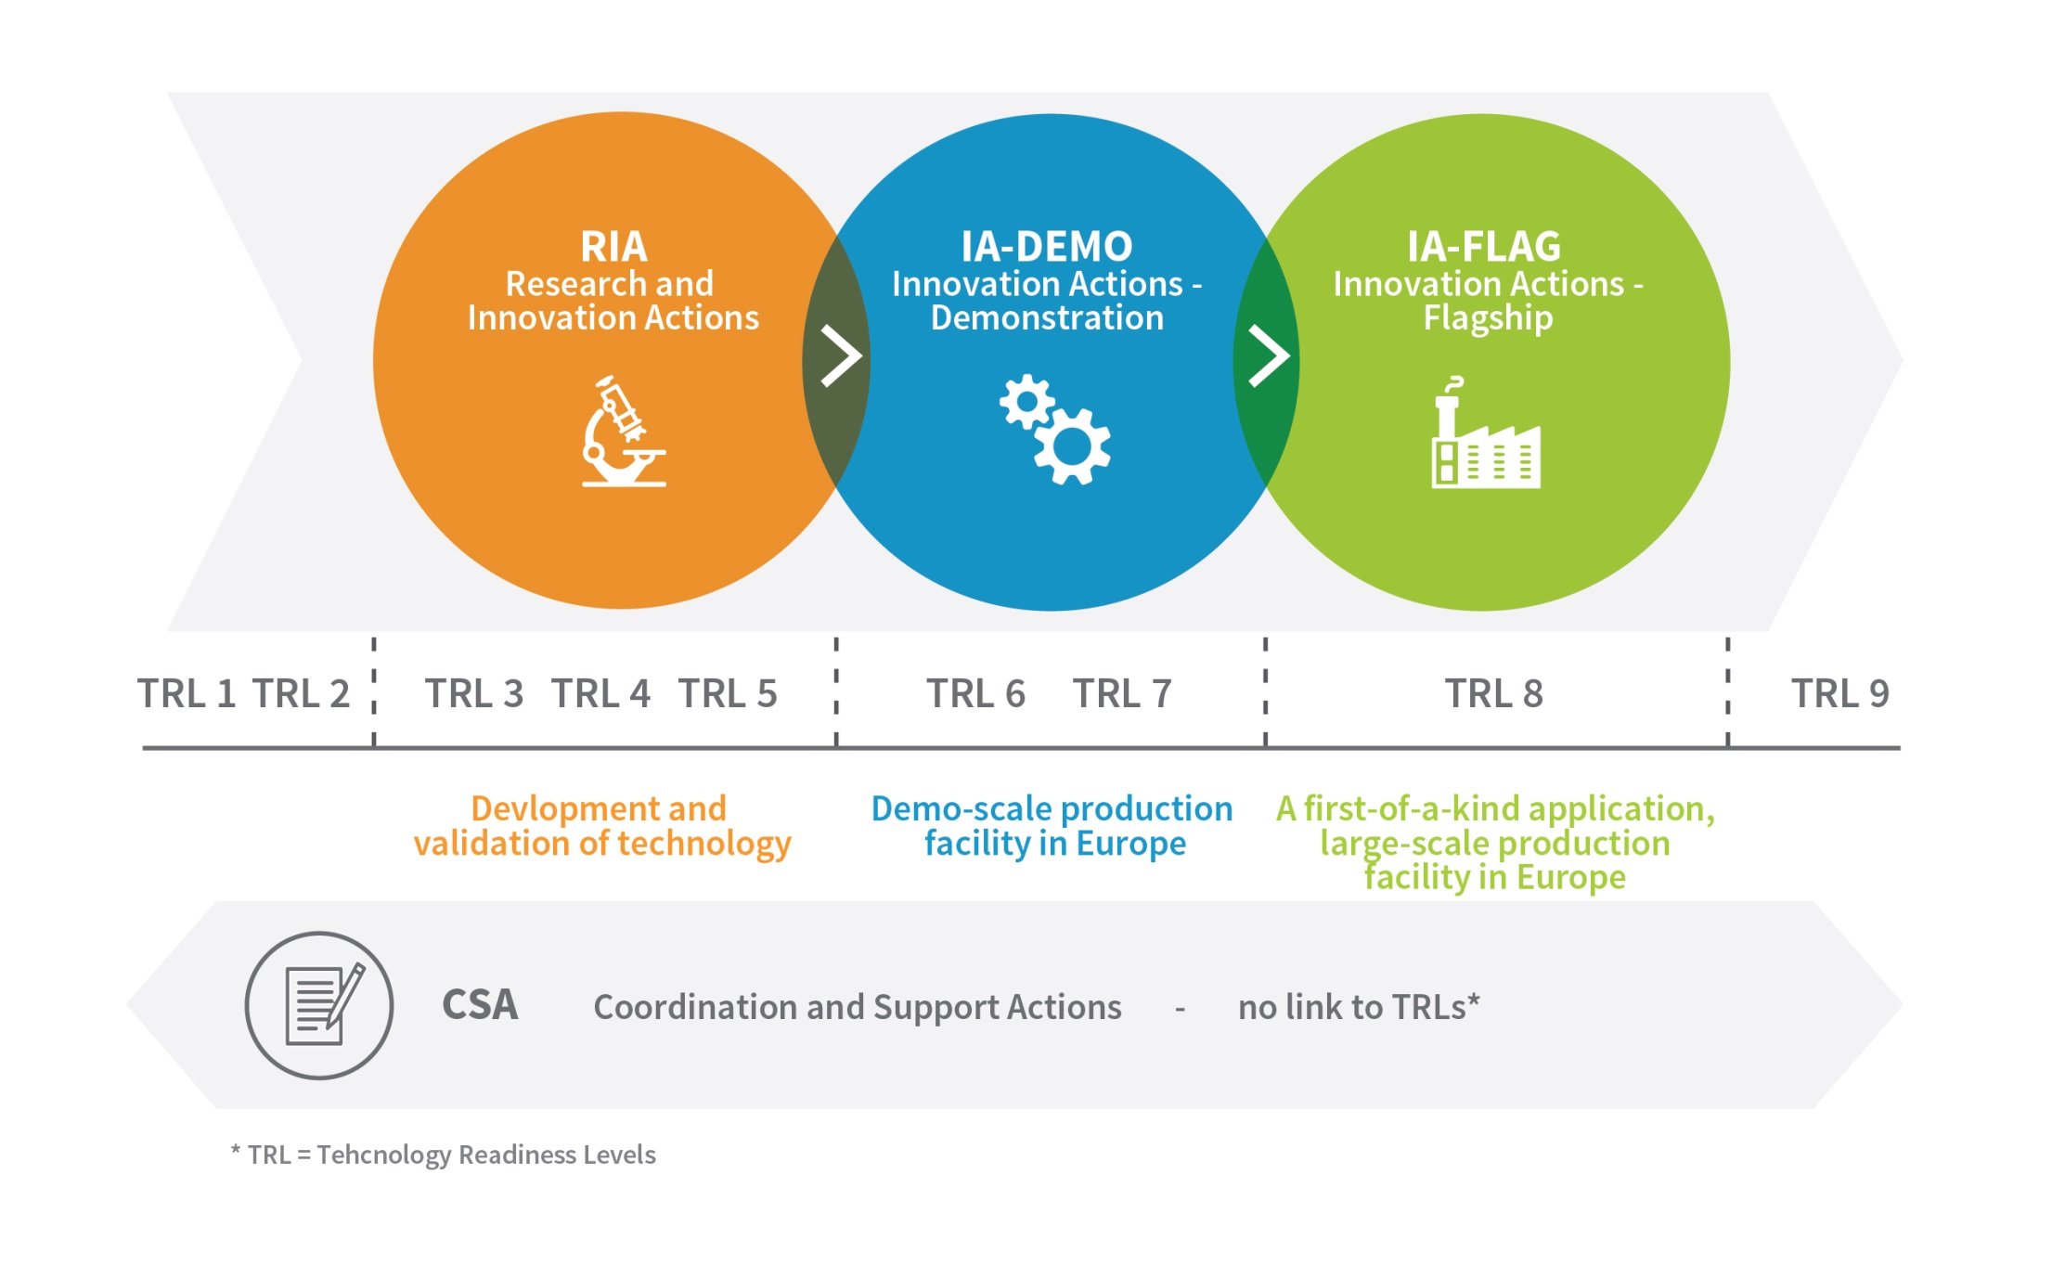
TRLs vs. Types of actions

Slide 17
Table of contents
Bio-based Industries Joint Undertaking
  Mission and objectives
  Implementation (AWP 2017)
  Statistics (IE case)
Evaluation process and evaluation criteria
How to participate?

Slide 18
MS: distribution of applicants Calls 2014-2016

Slide 19
MS beneficiaries
Calls 2014-2016

Slide 20
Distribution of beneficiaries per country from EU-15 and EU-13 in Calls 2014-2016
EU-13
Notes:
Positive trends: Poland, Croatia, Slovakia.

Slide 21
Table of contents
Bio-based Industries Joint Undertaking
  Mission and objectives
  Implementation (AWP 2017)
  Statistics (IE case)
Evaluation process and evaluation criteria
How to participate?

Slide 22
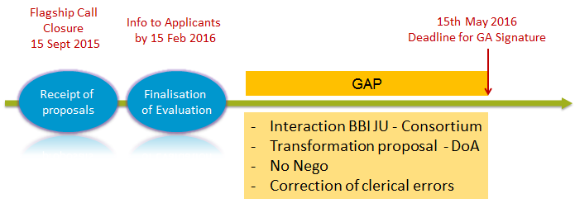

Evaluation process
Admissibility check
Evaluation of proposals
Grant preparation
Grant signature
Eligibility check
Call closure
8 months
GA signature
CALL2017
07/09/2017
07/05/2018

Slide 23


Admissibility - Eligibility check
Evaluation of proposals
Grant signature
Grant Preparation
At least 3 experts
STEP 1
(remotely):
Individual evaluation
Evaluation
Result Letter
Ranked list of proposals
STEP 2
(centrally in Brussels):
consensus group
For flagships:
Hearings
Ethics evaluations
(in parallel)
List of proposals for possible funding
Notes:
After the finalization of the eligibility check, BBI JU will proceed with the evaluation
BBI personnel is not evaluation the proposals. For this part of the process, we are assisted by Independent Experts.
Before the experts start the evaluation, the should sign the confidentiality agreement with BBI and also declare the Non CoI
BBI JU assigns at least three experts per proposal
As a first step, the experts will start working remotely and they will perform the individual evaluation based on the H2020 evaluation criteria.
Afterwards, they will gather to Brussels to discuss and agree with a consensus and the final scores for each proposal.
HEARINGS
In order to support the evaluation process, we organize Hearings only for FLGASHIPS and will most probably take place in OCTOBER
During the HEARINGS the experts will have the opportunity to discuss with the FLAGSHIPS COO only for issues related to TRL and business plan. Experts could also ask additional questions that derive solely from the context of the submitted proposal
The questions will be sent to the CO in advance in order to get prepared
Please note that if a COO provides during the HEARINGS additional elements that change the initial proposal, will not be accepted.
ETHICS
In parallel with the scientific evaluation, BBI is recruiting independent experts to perform the ethics review which is an essential part of the evaluation process. Proposal failing to receive an ethic clearance will not be considered for possible funding.
Therefore, before finalizing your proposals, please consider all ethical issues and complete carefully the ethics section in the PART A of your proposal.
After the finalization of the evaluation, the experts will draw a list of the proposals for possible funding.
Directly afterwards, the experts will finalise the RANKED list of the proposals. The list will be submitted to the BBI JU GB for approval.
As soon as the list is approved, BBI JU will inform the COOs on the evaluation results via the Participant Portal

Slide 24
Evaluation Criteria
H2020 rules apply: there are 3 main evaluation criteria
Excellence
WHAT?
BBI specific sub-criteria
IA: coverage of the all Value Chain
RIA/IA: Extent to which consortium contribution, including additional investment, will help maximising the impact of the action
Impact *
SO WHAT?
IA: Soundness of the business case and business plan
IA: TRL
Implementation
HOW?

Slide 25
Admissibility - Eligibility check
Evaluation of proposals
Grant signature
Grant Preparation
SCORES
0 Proposal does not meet the criterion at all or cannot be assessed due to missing or incomplete information
1 Poor – serious weaknesses
2 Fair – goes some way to meeting criterion, but with significant weaknesses
3 Good – but with a number of shortcomings
4 Very good – but with a small number of shortcomings
5 Excellent – meets criterion in every relevant respect. Any shortcomings are minor
Four thresholds
Excellence score = min. 3/5
Implementation score = min. 3/5
Impact score = min. 4/5
The sum of the three individual scores = min. 11/15
For Innovation actions, to determine the ranking, the score for the criterion ‘impact’ will be given a weighting of 1.5
Notes:
Our experts use exactly the same scoring structure of the H2020 and the score range is between 0 to 5
Proposal receives scores from 3 to 5 are considered good, very good and in some cases excellent.
We have also 4 types of thresholds according to the evaluation criteria
For Excellence and Implementation the threshold is 3
And for Impact is 4.
However, the overall threshold, applying to the sum of the three individual scores, has to be 11.
For Innovation actions, to determine the ranking, the score for the criterion ‘impact’ will be given a weighting of 1.5

Slide 26
Evaluation Criteria
EXCELLENCE | IMPACT | IMPLEMENTATION
Clarity of the objectives Credibility of the approach Soundness of the concept Ambition , innovation potential, beyond the state of the art (RIA-IA) Coverage of the whole value chain (raw materials, equipment and technology suppliers and end users) (IA) | Expected impacts in BBI JU working Plan Innovation capacity and integration of new knowledge Competitiveness and growth of companies Any other environmental and socially important impacts Exploitation and dissemination (including IPR management) Communication Extent to which consortium contribution, including additional investment, will help maximising the impact of the action (RIA-IA) | Coherence and effectiveness of the work plan Complementarity of the participants Management structures and procedures Readiness of the technology (IA) Soundness of the business plan and business case (IA)

Slide 27
H2020 subcriteria EXCELLENCE
Clarity and pertinence of the objectives
  Are the objectives clear, structured, well-quantified (if applicable),...
  ...and are they linked (pertinent) to the topic text?
Soundness of the concept and credibility of the proposed methodology
  ‘Concept’: the ‘big idea’ behind the proposal
  ‘Proposed methodology’:
    How to go from ‘big idea’ to reaching the stated objectives
    Have all elements described in the topic text been taken into account (e.g. LCA)?

Slide 28

Example
I want to build a house (concept) to keep me dry when it rains (objective).
  2 examples of methodology:
  Good approach: hire an architect and builders, buy building materials, first build the walls and then the roof, etc.
  Bad approach: only use paper to build a house, build it myself, start with the roof, once the house has been built: ask an architect to take a look at it, etc.

Slide 29

H2020 subcriteria (RIAs and IAs)
H2020 subcriteria EXCELLENCE
Only for RIA and IA
Extent that proposed work is beyond the state of the art, and demonstrates innovation potential.
  What is the state of the art (SOTA)? What’s the benchmark?
  ...and how does your proposal go beyond the SOTA?
  clearly describe the (starting and end) TRL

Slide 30
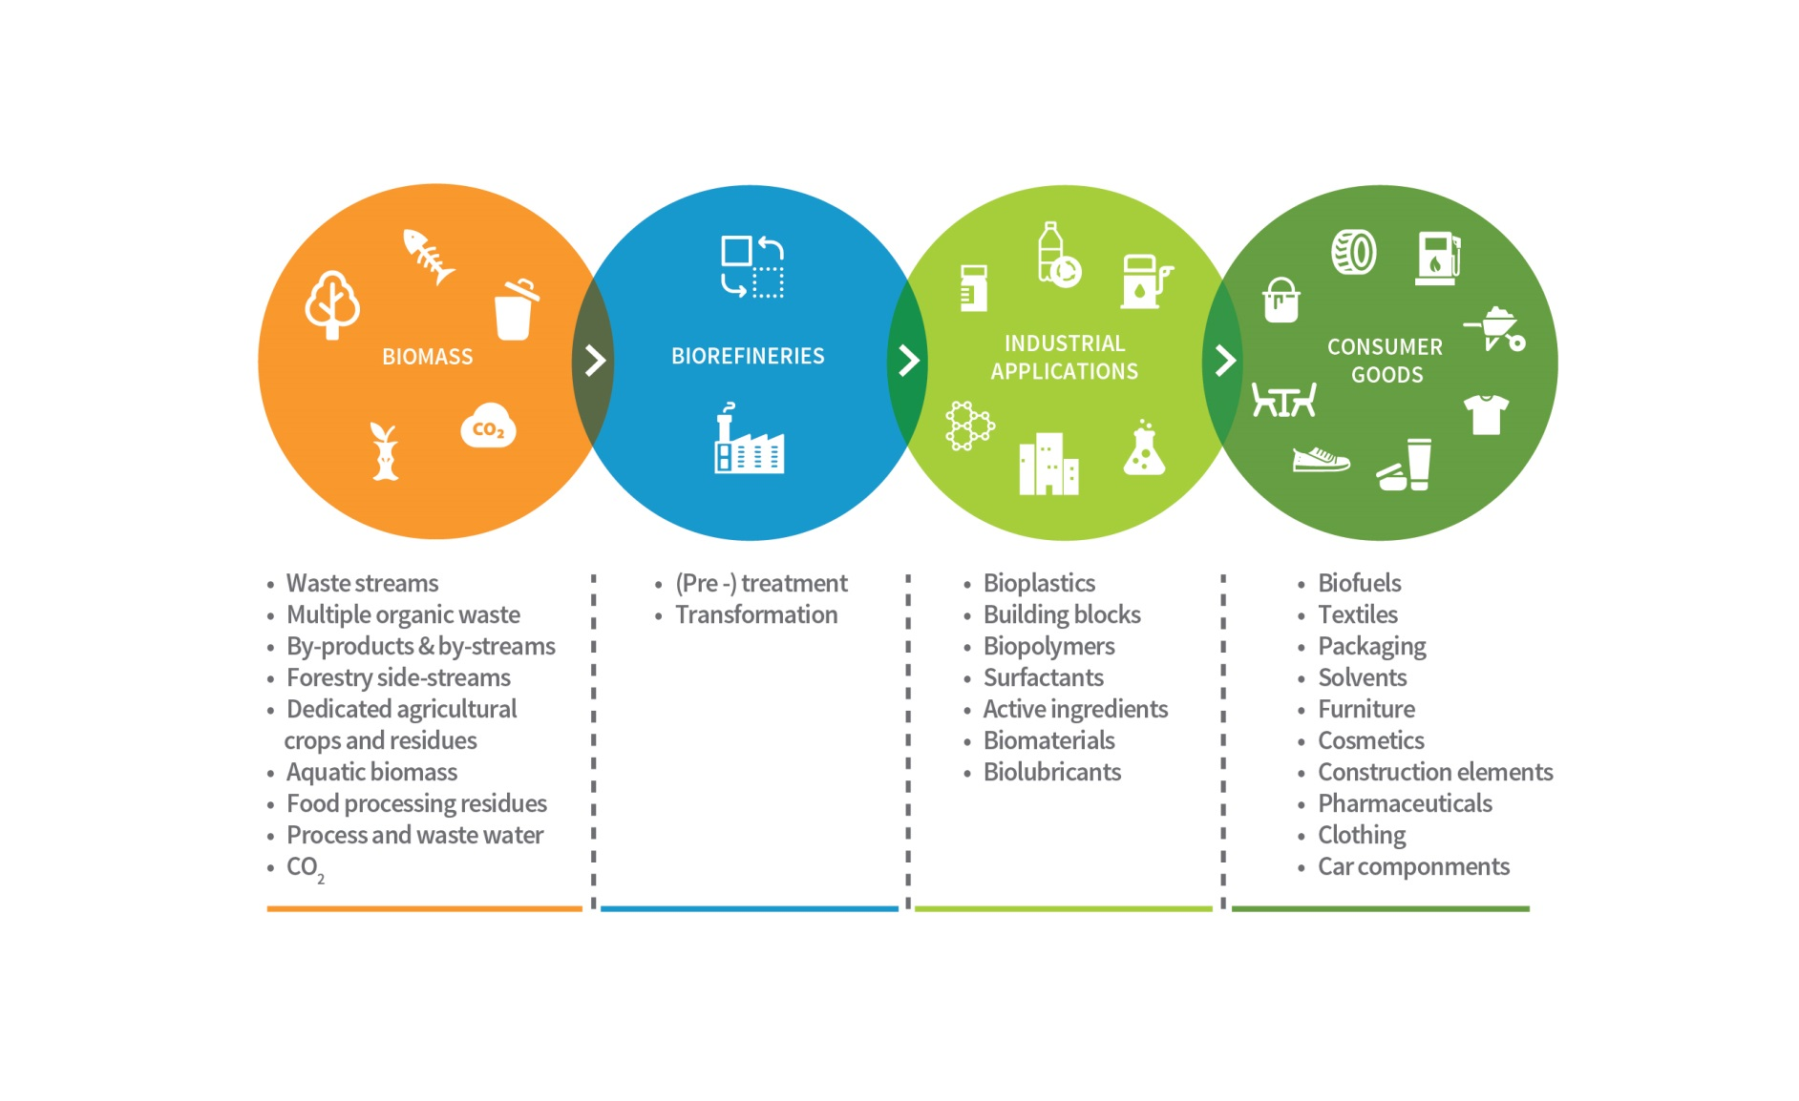
H2020 subcriteria EXCELLENCE
Only for RIA and IA
Coverage of the whole value chain
  Why? IAs are close to market => this subcriterion checks that your idea take into account biomass, processing and end products and markets;
  Why not in RIAs? Because RIAs can (topic-specific) focus on a specific technological problem in a part of the value chain

Slide 31
H2020 subcriteria IMPACT
Outputs of the project vs. the expected impacts mentioned in the work plan
  Are all ‘expected impacts’ listed in the topic text dealt with...
  ...in a qualitative AND quantitative manner?
  included BBI KPIs?
  describe explicitly how your proposal contributes to each listed ‘expected impact’, e.g. via a table

Slide 32

BBI JU KPIs
BBI JU specific objectives: demonstrate technologies; develop business models, set up flagship biorefinery plants:
KPI 1 New cross-sector interconnections in bio-based economy
KPI 2 New bio-based value chains
KPI 3 Cooperation projects
KPI 4 New building blocks based on biomass of European origin validated at demonstration scale
KPI 5 New bio-based building materials
KPI 6 New demonstrated ‘consumer’ products based on bio-based chemicals and materials
KPI 7 Flagships resulting from BBI JU funded projects

Slide 33
H2020 subcriteria IMPACT
Exploitation, dissemination and communication of project results (including IPR and - where relevant - research data management)
  Dissemination & exploitation: more than an eligibility criterion; this is also evaluated by experts
  Tips:
    Also provide quantative data (how many conferences, publications, target audiences,...) => be specific, avoid ‘generic’ diss./comm./expl. plans
    Include relevant (also public) deliverables
    Explicitly describe IPR (Intellectual Property Rights) management

Slide 34
H2020 subcriteria IMPACT
Extent to which the proposed consortium own contribution, including additional investments, will help maximising the impact of the action
  Clearly describe if and how much “own contribution” (‘in kind’, ‘in cash’ and/or ‘additional investments’) is included in the proposal...
  ...AND explain how this will maximise the impact of the action
  Don’t just list the amounts, also explain them

Slide 35

A programme implemented with private and public funds 2014-2020
€ 975 M
€ 975 M
€ 1755 M
TOTAL
€ 3705 M
+
=
(+- 75% from BIC)
‘Call for Proposals’
(‘in cash’ and ‘in kind’)
‘Additional Investments’

Slide 36

Consortium own contribution in projects
Private funding! 3 types of contribution:
➢ Contributions to cover the costs of activities of the project:
In kind contributions to the operational costs (IKOP)
  Costs incurred by consortium in implementing the project less the contribution of the BBI JU
In cash contributions at project level (in-Cash)
  Financial contributions from one consortium member to other/s
➢ In kind to additonal activities (IKAA)
  The industry is investing in additional activities, besides the contributions to implment the project, contributing to the objectives of BBI initiative (other EU funding programme can contribute to these costs, in that case it will not be counted as IKAA)
Notes:
How this is achieved? BIC members are providing contributions at the level of projects
Activities outside the work plan of the BBI JU contributing to the objectives of the BBI Initiative (investments at the implementation or exploitation phase infrastructure, durable equipment,…)

Slide 37
“Own contribution” in proposal?
Part A:
  ‘In kind’: can be derived from budget table (e.g. € 1 million costs, € 650k requested BBI JU contribution = € 350k ‘in kind’)
  ‘In cash’ and ‘additional investments’: cf. call-specific questions in the proposal’s ‘part A’

Slide 38
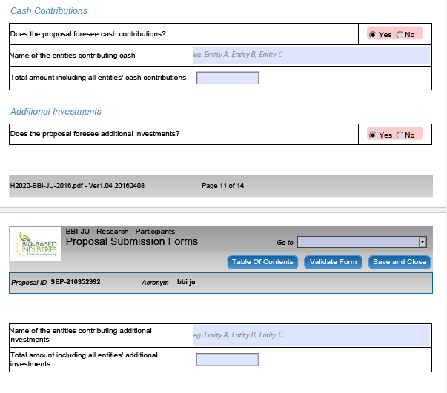
Part A: Call-Specific Questions
Cash Contributions
Additional Investments

Slide 39
“Own contribution” in proposal?
Part A:
  ‘In kind’: can be derived from budget table (e.g. € 1 million costs, € 650k requested BBI JU contribution = € 350k ‘in kind’)
  ‘In cash’ and ‘additional investments’: cf. call-specific questions in the proposal’s ‘part A’
Part B:
  To be described in more detail (incl. their impact) in section 3.4 (‘resources to be committed’)
  Additional investments: cf. table in Guide for Applicants (GfA)

Slide 40
H2020 subcriteria IMPLEMENTATION
Quality and effectiveness of the work plan (incl. deliverables), including resource allocation
  check coherence of budget allocation and timing throughout the proposal (e.g. list of deliverables and Gantt chart: same timing?)
  FAQ: difference between methodology (‘Excellence’) and work plan (‘Implementation’)?

Slide 41
Example: “What?” vs. “How?”
E.g. good approach in ‘house example’:
  “Hire an architect and builders; buy building materials; first build the walls, then the roof,…”
  Let’s consider the “Hire an architect and builders” step.
Example of good work plan
  Task 1: talk to friends who recently built a house in the same style as I want mine to be built, and perform a google search to find more info on building in general and questions to ask architects in particular;
  Task 2: I will discuss with and ask offers of at least 3 architects, informing them about my budget;
  Task 3: Then, I will assign credible resources (time and money) to the next tasks.

Slide 42
Example: “What?” vs. “How?”
Example of bad work plan
  Task 1: I will open the phone book, and sign a contract with the first architect I can find.
  Task 2: I will not discuss a budget with the architect, but leave him free to decide what/how to build. I believe (but have no proof) that I will be able to borrow any amount from the bank.
The methodology (“What?”) is the same, but the work plan (“How”?) isn’t.

Slide 43
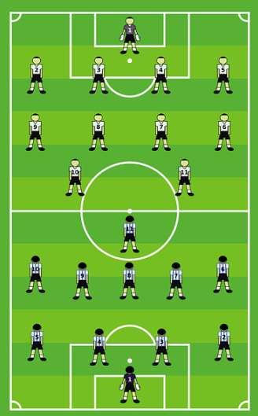
H2020 subcriteria IMPLEMENTATION
Allocation of tasks, ensuring that all participants have a valid role and adequate resources
  Football analogy:
    Sometimes, a certain amount of ‘home-grown’ players is required...
    ...but they’re only part of the team pro forma; they seldom play.
  convince expert-evaluators that you don’t have ‘token’ consortium members, e.g. via resource allocation (money talks...)

Slide 44
H2020 subcriteria IMPLEMENTATION
Management structures and procedures, including risk and innovation management.
  Consortium of 5 or 20 members: different management (structures) needed
  ‘Innovative’ management techniques are not necessary; it needs to work!
    explicitly mention / describe risk and innovation management...
    ...and include ‘real’ (not token) risks and mitigation measures

Slide 45
H2020 subcriteria IMPLEMENTATION
Soundness of the business case and business plan
  Why? IAs are close to market => business case and business plan are needed
  How? See Guide for Applicants and proposal template (bullet points describing business case & plan requirements)
  FAQ: how much info is needed?
    “(Further) details can be provided in part B – sections 4-5” (= not included in 70-page limit)
    (Only) for Flagships: additional info via hearings

Slide 46
H2020 subcriteria IMPLEMENTATION
Readiness of the technology
  clearly indicate the start and end TRLs
  “In particular, for flagships applicants must demonstrate that by the time of the submission of their application they have been operating relative demonstration scale plants at a significant production capacity (justification shall be provided in the proposal).”

Slide 47
How to write a good proposal?
Ensure that expert-evaluators quickly find the right information to assess the evaluation subcriteria.
How?
  Be aware of the evaluation subcriteria of ‘your’ type of action (CSA, RIA, IA)...
  ...and provide (explicit) answers to these subcriteria in your proposal...
  ...using the proposal structure / template described in the Guide For Applicants (GfA)

Slide 48

Evaluation of proposals
Grant preparation
Grant signature
Online grant preparation: The process is supported through the Participant Portal.
Follow your proposal: The grant agreement and its annexes must not differ from the proposal. No negotiation in H2020.
Timeframe: The Grant Agreement must be signed at the latest 8 months after the call deadline
SME self-assessment (check beforehand - In RIA and CSAs: no confirmed SME = no funding)
SME self-assessment
Financial Viability of the Coordinator (select your COO wisely) - Financial Viability Self-Check

Slide 49
Most common mistakes
Excellence
  Progress beyond the state of the art not clear
  Parts of the topic are not covered or not sufficiently addressed (only briefly mentioned)
  Read the topic carefully and include in your proposal all it is requested (i.e. proposals should include, should address etc.)

Slide 50
Most common mistakes
Impact
  Some expected impacts are not addressed
  Lack of consortium own contribution
  Generic communication & dissemination activities
  IPR management lacks of details
  Address all expected impacts
  Be specific in the communication plan
  The lack of consortium own contribution will not get you to the maximum score

Slide 51
Most common mistakes
Implementation
  Tasks insufficiently described
  Risk analysis not complete (not all risks addressed, delivery and technical, and likelihood missing)
  IA: business case and plan not detailed
  Describe the work you will carry out
  Do not give for granted evaluators know
  Be as much specific as possible

Slide 52
Table of contents
Bio-based Industries Joint Undertaking
  Mission and objectives
  Implementation (AWP 2017)
  Statistics (IE case)
Evaluation process and evaluation criteria
How to participate?

Slide 53
Via H2020 & BBI JU IT tools...
Participant Portal
  Register organisations, topic search, proposal submission,...
  H2020 online manual
BBI JU website
  BBI JU-specific info (incl. FAQs)
  Info day 28 Apr 2017: presentations & recording
  BBI Partnering Platform

Slide 54


Slide 55

...and personal contact
Your NCP and EEN contacts
BBI partnering platform
BBI JU project participants
  http://cordis.europa.eu/projects/home_en.html
  https://www.bbi-europe.eu/projects
BIC (member) activities

Slide 56
Do you have BBI expertise?
Please consider registering as an expert on the Participant Portal (PP)
  http://ec.europa.eu/research/participants/portal/desktop/en/experts/index.html
  BBI = broad field => different expertise needed!
  As a BBI JU evaluator, you’ll gain valuable BBI JU / H2020 insights...
  Call 2017 expert-evaluator invitations
  First invitations have been sent in Mid April 2017
  ...so if you haven’t registered yet, please do so by asap AND e-mail experts@bbi.europa.eu

Slide 57

Thanks for your attention
…and good luck!
www.bbi-europe.eu

