Slide 1




BBI Coordination - What's involved? The LIBRE example
BBI Event June 6th 2017
Dr Maurice N Collins

Slide 2
Background and Becoming Aware of the Call
Biomaterials – Biopolymers – Medicine and Electronics
NCP
Research Office @ UL
Brokerage Events

Slide 3
H2020 Proposals
Proposal calls on specific topics
Consortiums (Consisting of Universities, RPOs, SMEs and Large Industry)
Partner or coordinator
70 page document plus appendices
Threshold 13/15
Excellence
Impact
Implementation

Slide 4
The Role of the Coordinator in a H2020 Proposal - Build the Consortium Carefully

Slide 5
Writing the Proposal
Organize proposal according to outline of the call evaluation criteria
Following the prescribed format makes reviewers happy and more generous
Making reviewers work hard hurts you!

Slide 6
Tips 1. Summary
Summary captures the essence of your proposal – must be clear, concise, well articulated and logical

Slide 7
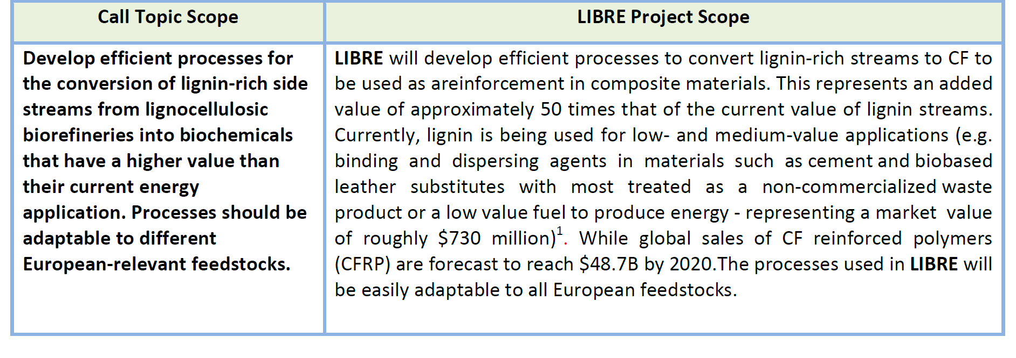
TIPS 2. Align your proposal Clearly to the call

Slide 8
TIPS 3. Tabulate and Bullet

Slide 9
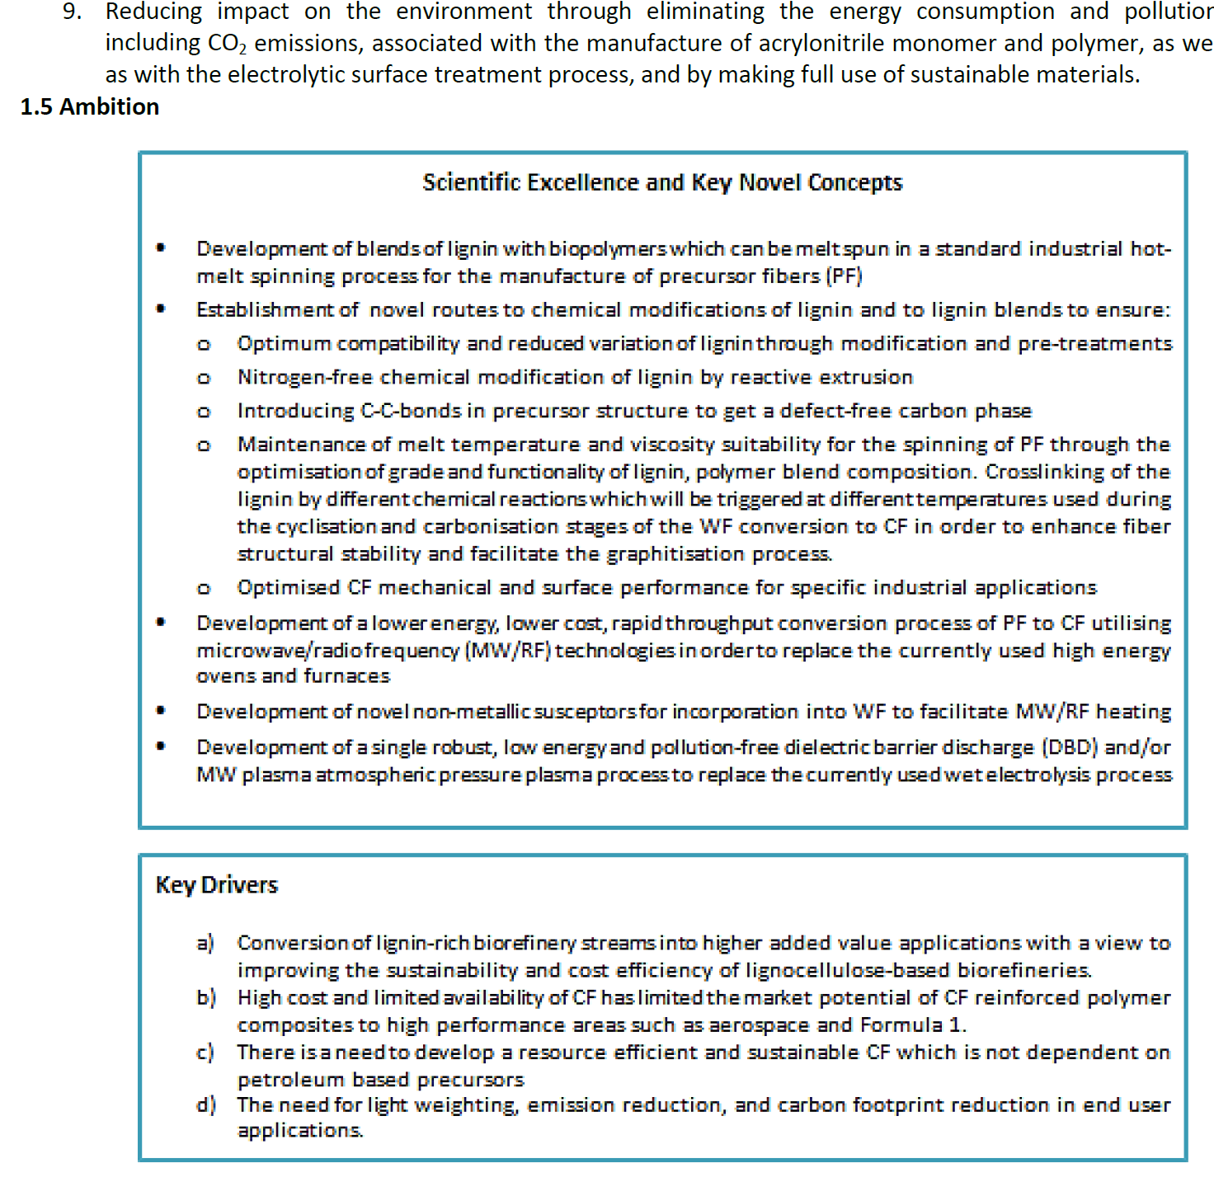

Slide 10
TIPS 4. Address Expected Impact and More….
Strategic Impact
Industrial Impact
Scientific Impact
Environmental and Sustainability Impact
Policy Impact
Boosting EU competitiveness

Slide 11
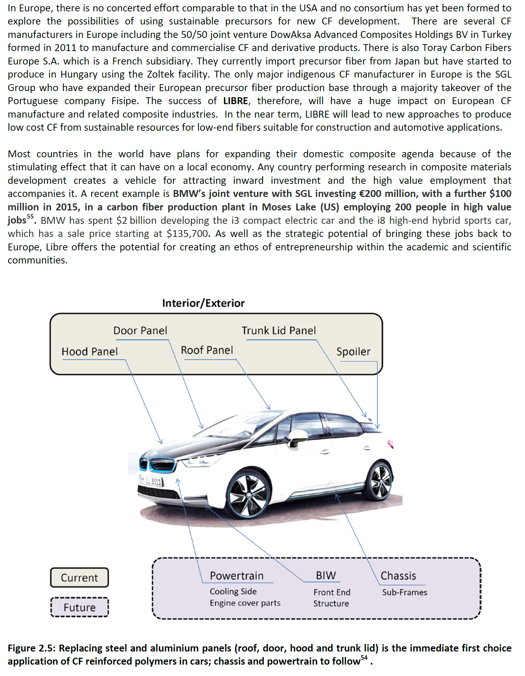
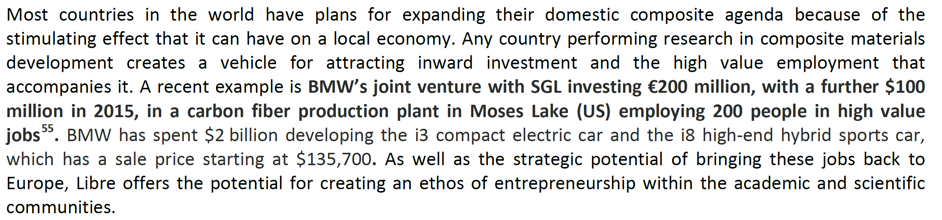
TIPS 5. Highlight Key Points in the text

Slide 12
Post Award - The Role of the Coordinator in a H2020 Proposal
Description of Actions
Consortium Agreement
Grant Agreement
Legal Entity Appointed Representative (LEAR)

Slide 13
The Role of the Coordinator in a H2020 Proposal
Manage financial accounting for all partners
Monitor project progress based on WP Plans and Liaise with WP leaders
Manage progress meetings and reports
Mitigate risks
Contribute to the Technical objectives
Mange KPIs and In-kind contributions
Chair Dissemination, Business planning and Exploitation activities
Regular contact with the Project officer

Slide 14
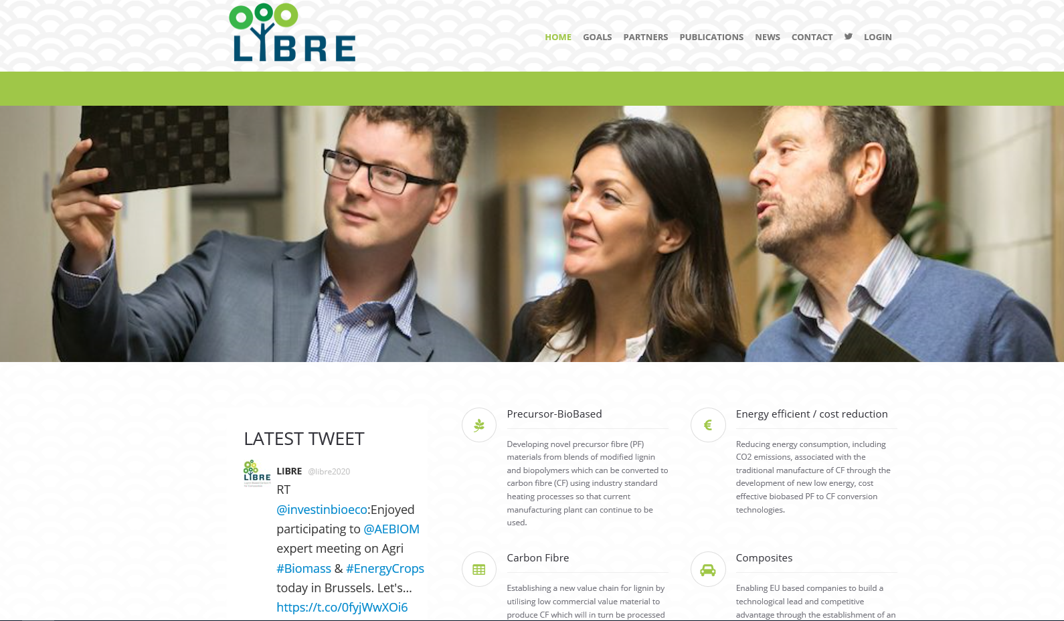
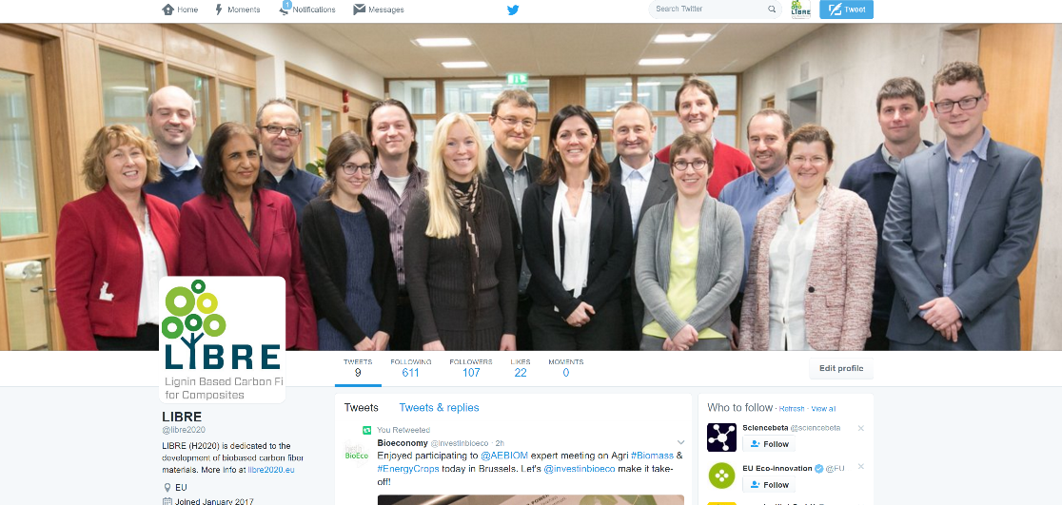
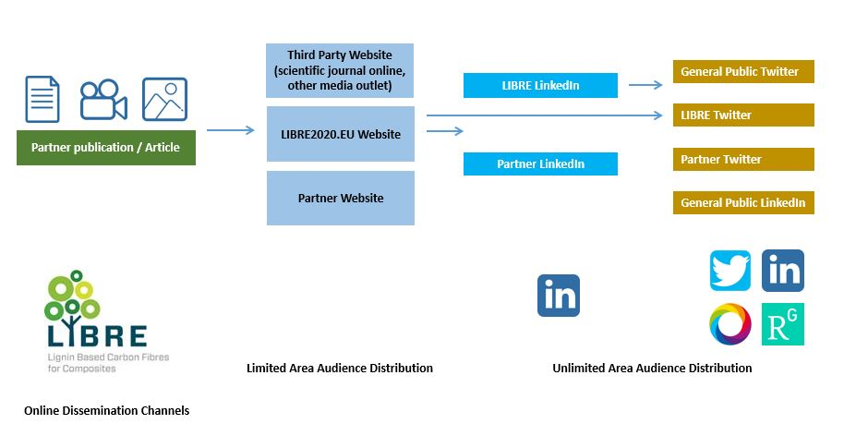
Dissemination
@libre2020

Slide 15



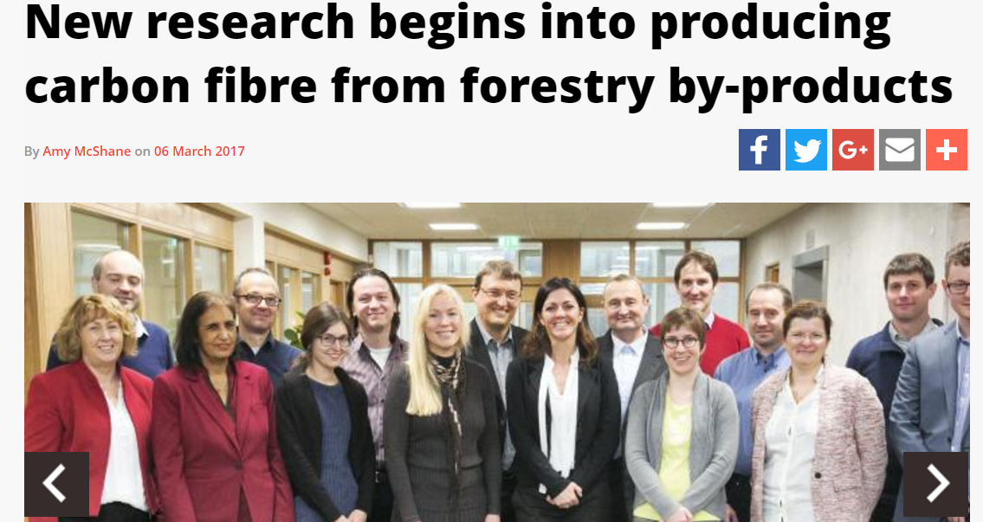
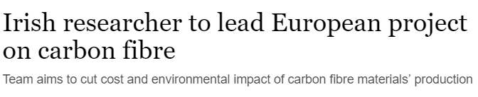

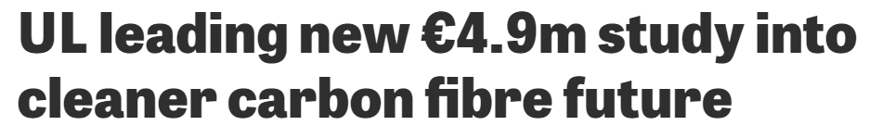
Post Award Benefits

Slide 16
Things to Consider
Factors We Can’t Control
Factors We Can Control
Stiff competition from other applicants
Limited availability of funds for certain program areas within funding agency
Quality of your proposal
Requires careful research and planning
Requires meticulous execution

Slide 17
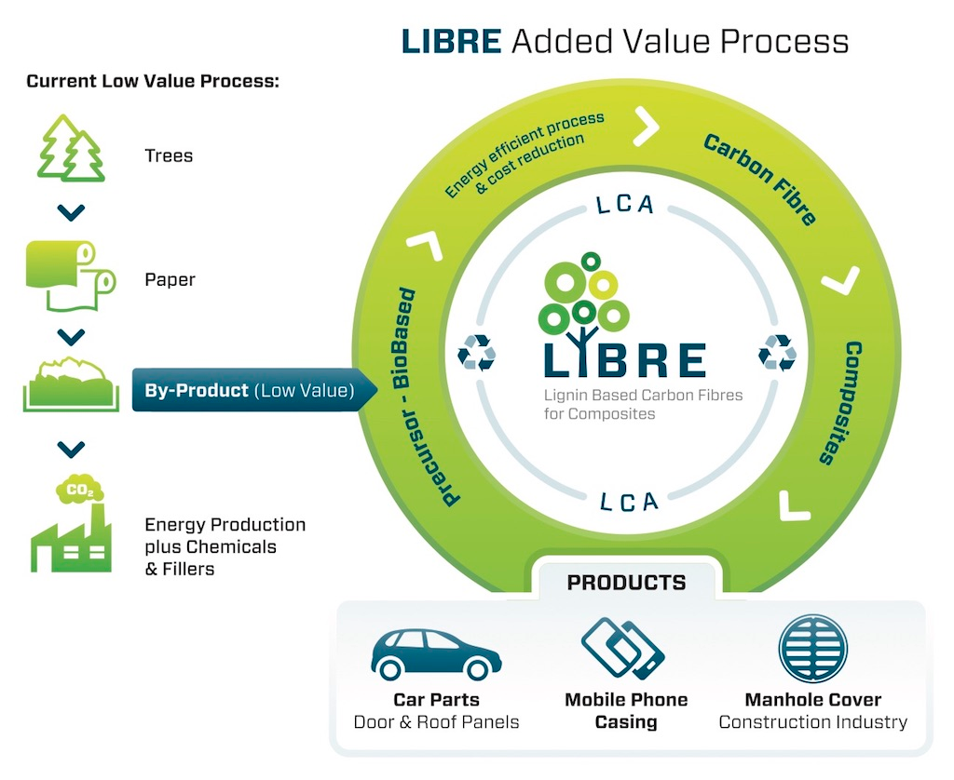
What is LIBRE?
Move away from petroleum based materials
Increased Sustainability
Reductions in energy consumption and greenhouse gas emissions
Non-Solvent processing
Cost reduction

Slide 18
People Who helped along the way
Dr Cathal Linnane (UL Research Office)
Mr Patrick Barrett (National Contact Point)
Dr Terry McGrail (ICOMP)
Dr Erik Frank (ITCF)

Slide 19
Thank you for your attention
Acknowledgement
This project has received funding from the Bio Based Industries Joint Undertaking under the European Union’s Horizon 2020 research and innovation programme under grant agreement No 720707.

Slide 20
Contact Details
Dr Maurice N Collins BSc MSc PhD MRSC
http://stokes.ie/author/mauricecollins/
www.Libre2020.eu
@libre2020
@DrMNCollins
Maurice.Collins@ul.ie
Best of Luck!

