Slide 1
The Bio-Based Industries Consortium
Bridging the gap between lab and market and meeting societal challenges
Bioeconomy Workshop
June 6, 2017, Dublin, Ireland
Suzy Renckens
Public Affairs and Communications

Slide 2
Outline
Introducing BIC
The long-term strategy: the Strategic Innovation and Research Agenda (SIRA)
The (short-term) actions via the annual working plans (AWP)
BIC Public Affairs & Communications
Role of the regions
Why should join BIC?

Slide 3

THE BIO-BASED INDUSTRIES CONSORTIUM

Slide 4



About the Biobased Industries Consortium (BIC)
&
→
EC
BIC
BBI JU
The Bio-based Industries Consortium (BIC) was established in 2012 to represent the private sector in the Bio-based Industries Joint Undertaking (BBI JU), a Public-Private Partnership with the European Commission.
BBI JU is one of the pillars of the European strategy "Innovating for Sustainable Growth: A Bioeconomy for Europe (2012)" that calls for a bioeconomy as a key element for smart and green growth in Europe.

Slide 5



BBI JU: Budget for 2014 - 2020
€ 975 M
€ 975 M
€ 1755 M
TOTAL
€ 3705 M
+
=
(about 75% from BIC)
Call for Proposals
(in cash and in kind)
Additional Activities
Budget should cover operational costs through 2024

Slide 6
Why a PPP with the EC?
To ‘de-risk’ an emerging industry through:
A clear framework that brings clarity for activities & investments
Long term stability and predictability
A joint approach, across sectors, across Member States
Joint financial commitment and a jointly defined programme, that will unite parties that would otherwise find these activities too risky for an individual sector/company
Leverage further investments
Industry driven and therefore result and market-oriented

Slide 7
Bio-based Industries Vision
To accelerate the innovation and market-uptake of bio-based products and
to position Europe as a world-leading, competitive bioeconomy
Leading the transition towards a sustainable society while decoupling economic growth from resource depletion and environmental impact.

Slide 8
The Mission of BIC
  Define the Strategic Innovation & Research Agenda (SIRA)
  Lead the drafting of the annual BBI Work Plans & topics for the Call for Proposals
  Mobilise stakeholders: industry (large, SMEs, SME Clusters), research organisations, universities, regions and all other relevant stakeholders across Europe
  Improve conditions for “Access to finance” in Europe
  Endeavour a favourable policy environment
  Create awareness about the bioeconomy, also at Regional level

Slide 9
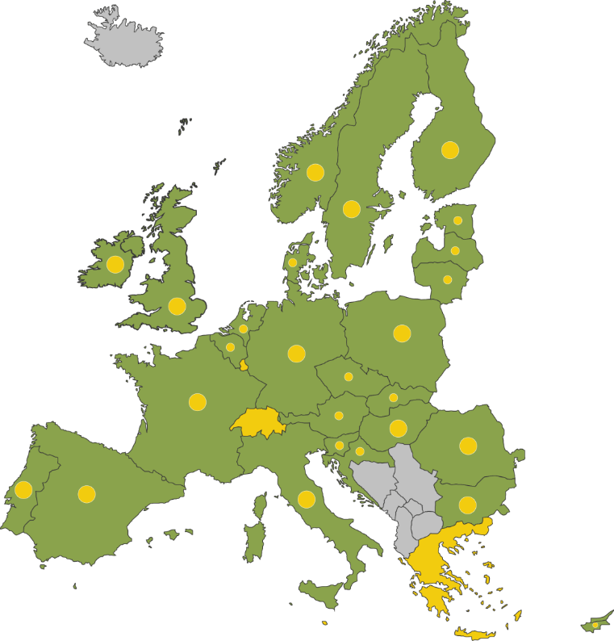
Our members – per 5 May 2017
■ 77 Full members
  31 Large industries
  30 SMEs
  16 SME Clusters (representing 110 SMEs)
  Several industrial sectors covered
    Agriculture & Agri-food
    Forestry and Pulp & Paper
    Technology providers
    Chemicals and materials
    Energy
    Aquatic
    …
■ 146 Associate members
  Universities, RTOs, European associations & organisations, Technology Platforms (ETPs), public institutions, regional organisations, private banks, …

Slide 10
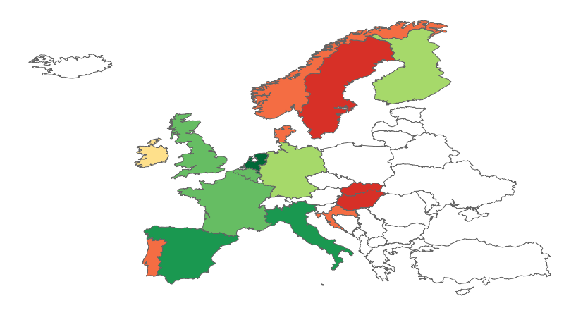
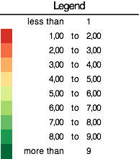
BIC Full Members per Country (Current membership)
+1 from Israel
+1 from US

Slide 11
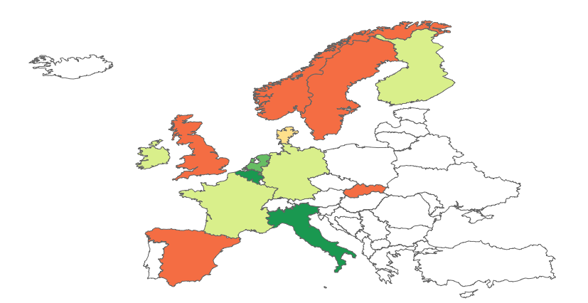
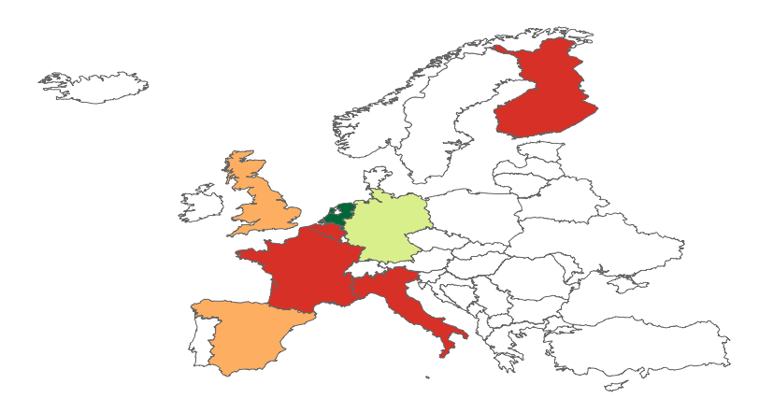
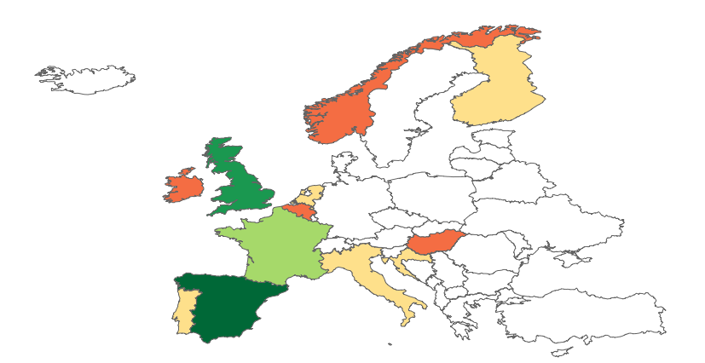
BIC Full Members per Country (Current membership)
LE
Germany: many SME Clusters, no SMEs
Spain, UK: many SMEs, few SME Clusters
Finland, Belgium, Italy: many LE, few SMEs or SME Clusters
Almost completely missing Eastern Europe
SME Cluster
Almost completely missing smaller Mediterranean Countries
SME

Slide 12
Strategic Innovation & Research Agenda (SIRA)
Notes:
Our long term strategy

Slide 13
Strategic Innovation & Research Agenda (SIRA)
Build new bio-based value chains by optimising feedstock use, developing new biorefining technologies, and creating a favourable business and policy climate to accelerate market acceptance of bio-based products
Involving different industrial sectors
Build a bioeconomy based on:
  Local sourcing
  Local production
  Job creation
  Rural development
  Sustainability
  Efficient use of resources

Slide 14
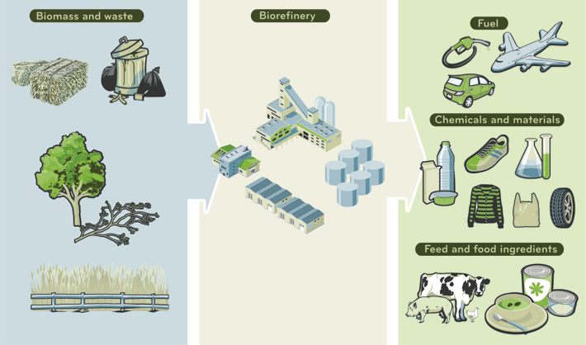
Bio-based industrial value chains
The concept
Converting Europe’s untapped biomass and wastes into greener everyday products

Slide 15
Strategic Innovation and Research Agenda
The SIRA sets out the main technological and innovation challenges to developing sustainable and competitive bio-based industries in Europe
The SIRA identifies:
Research & innovation activities (RIAs);
Demonstration activities (Demos)
Deployment activities (Flagships)
to be carried out by the Bio-Based Industries Joint Undertaking (BBI JU)
Disclaimer in March 2013 BBI SIRA (Strategic Innovation and Research Agenda):
  ‘the BBI SIRA will be frequently adjusted based on technology and market developments, results obtained and ambitions of new members entering the BIC’.

Slide 16
Drivers for SIRA adjustment
To widen the scope for participation in the BBI programme
To incorporate the state-of-play of the world around us and to reap benefits thereof
To reflect the political context
To better align the bio-based industry’s ambitions with societal expectations/needs

Slide 17
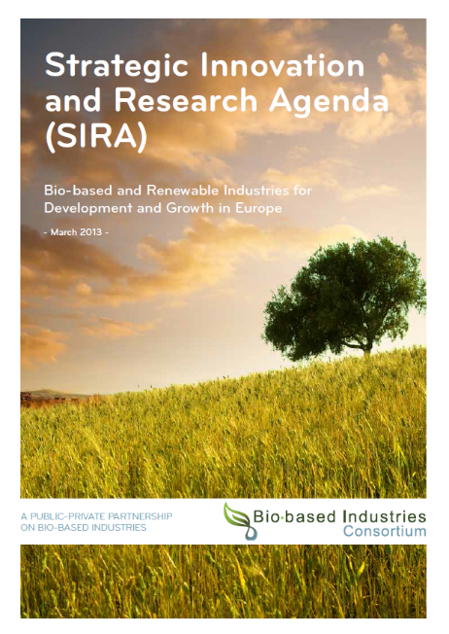

Updated basis for annual work plans
New Strategic Innovation & Research Agenda (SIRA):
    More/other industrial sectors: manufacturing, technology providers
    Broader geographical spread: extend into CEE; link with regions
    More focus on demand/market: link with brand owners and market actors
Version 1 (2013)
Version 2 (2017)

Slide 18
SIRA update
Addressing the four strategic orientations of the bio-based industry in Europe,
Foster a sustainable biomass-feedstock supply to feed both existing and new value chains.
Optimise efficient processing for integrated biorefineries through R&D&I.
Develop innovative bio-based products for identified market applications.
Create and accelerate market uptake of bio-based products and applications
‘Multi-value-chain’ approach, pursuing crossover between ‘traditional’ value chains, more opportunities to convert the feedstock into chemicals, materials, food ingredients and feed, and transport fuels.

Slide 19
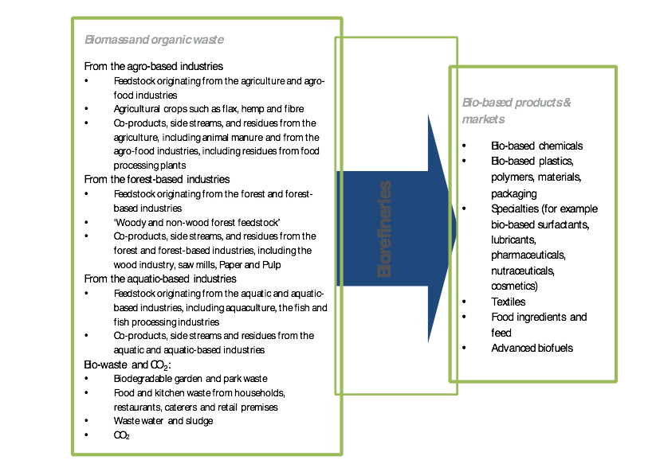
Value chains according to BIC

Slide 20
ANNUAL WORK PLANS (AWP)
Topics per strategic orientation and related focus areas

Slide 21
AWP 2017 - highlights (1)
Strategic orientation 1: Feedstock
• Biomass diversification: ‘beyond lignocellulose’
• Resource efficiency: use ‘waste’ (various sources)
Strategic orientation 2: Process
• Cascading
• Keep ’complexity’ in biomass
• Novel microbial and enzymatic activities

Slide 22
AWP 2017 - highlights (2)
Strategic orientation 3: Products
• New/additional functionality
• Novel, breakthrough bio-based products
• Protein and other high value products
• Bio-based fertilising products
Value added lignin products
Strategic orientation 4: market uptake
• ICT to improve efficiency of biomass supply chain
• Partnership with brand owners & consumer representatives

Slide 23

Process to prepare work plan & call
Bio-based Industries Consortium
BIC Programming Working Group
+
Programming Core Team (representing all sectors, regions, large companies, SME)
Scientific Committee
States Representatives Group
BIC staff: survey all stakeholders for annual priorities
PWG prepares Priority Paper + annual work plan topics (liaise with associate members)
BIC staff discusses AWP with EC
BBI: seeks advice from SC and SRG
BIC: agreement on final version by BIC General Assembly
BBI: endorsement by Governing Board
BBI publishes the (open) calls
5. BBI organises evaluation by independent experts (on excellence, impact + implementation)
6. BBI negotiates and signs contract with winning consortia (consortium agreement and grant agreement)

Slide 24
Steps towards an annual work plan
Final
Written procedure with BBI GB
Pre-final
Approval process with BIC GA
'Reality check’
BIC members’ commitment
(financial + proposal)
Topics for the AWP
RIA-IA-CSA
Budget
Specific challenges
Priority Paper
‘Broad challenges’
Feb | April | May | June | July | Sept | Oct | Nov | Dec
Involved in the various steps:
BIC members –– EC – SC & SRG BBI – BBI JU Office

Slide 25
PUBLIC AFFAIRS & COMMUNICATIONS

Slide 26
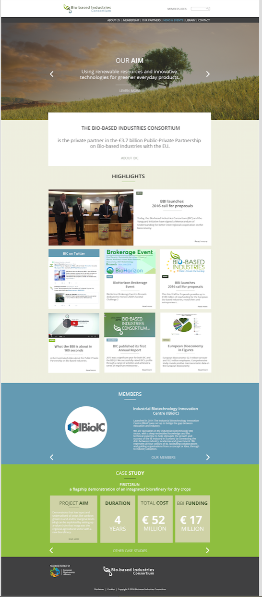
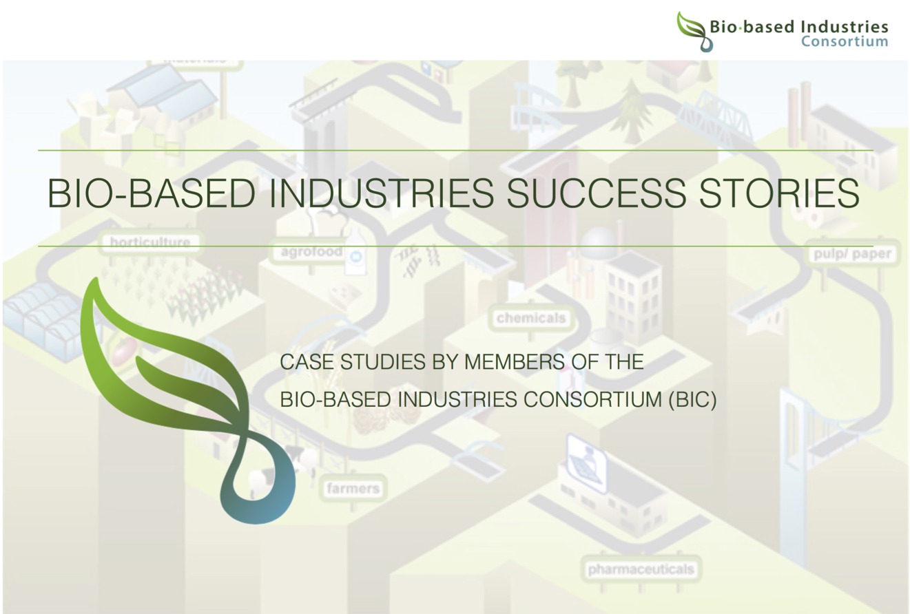
BIC communications

Slide 27
Public affairs & relations
BIC’s positioning and outreach with regard to EU Policies to endeavour a bioreconomy favourable policy environment
  H2020 and BBI JU Mid-term review (high priority)
  Review of the bioeconomy strategy (high priority)
Communications and stakeholders relationships (high priority)
  Through smart and targeted communication
Advocacy, also through the European Bioeconomy Alliance (EUBA)
  Position papers: circular economy, waste package, biomass supply, green public procurement
  Letters to EU policy makers
  Meetings with EC, MEPs, Perm Reps, …

Slide 28
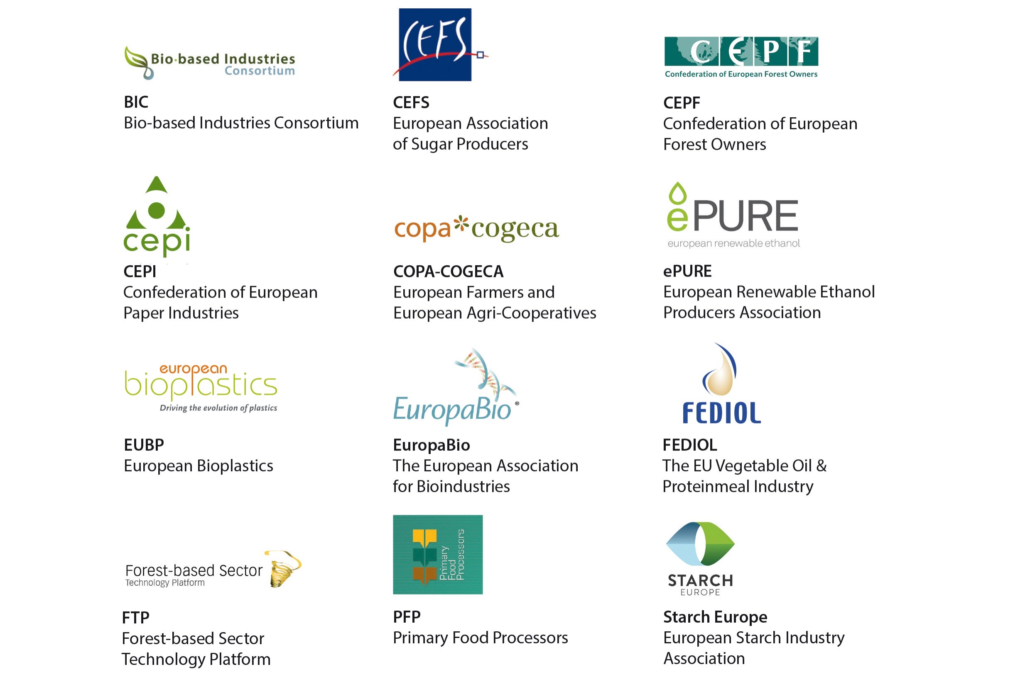
EUBA: informal alliance of trade associations

Slide 29
IMPORTANT ROLE FOR THE REGIONS

Slide 30
Importance of the regions
Opportunities to “valorise” feedstock: agricultural crops or forestry, marine feedstock, waste from food industry, municipal waste, ….
Regions can help setting up local value chains, to the benefit of farmers and local industry
Regions can use regional and rural development funds and other finances to support and attract investments, and as such create new jobs and opportunities for their primary sector.
BIC collaborations with regions:
  Awareness raising activities on BIC and the BBI JU
  Synergies and co-funding opportunities to create a more favourable investment environment for bio-based industries in Europe
  Connect actors across regions and sectors along new value chains
  Sharing best-practices, exploit complementarity, sharing infrastructure, …

Slide 31

BIC General Assembly Feb 2017
Open session focused on ‘Bioeconomy’ regions to stimulate interaction between bio-based industries and regional authorities
  Presentation of the Vanguard Initiative
  Pitches by 13 regions across Europe
  Brochure with contributions from 30regions (living document)

Slide 32
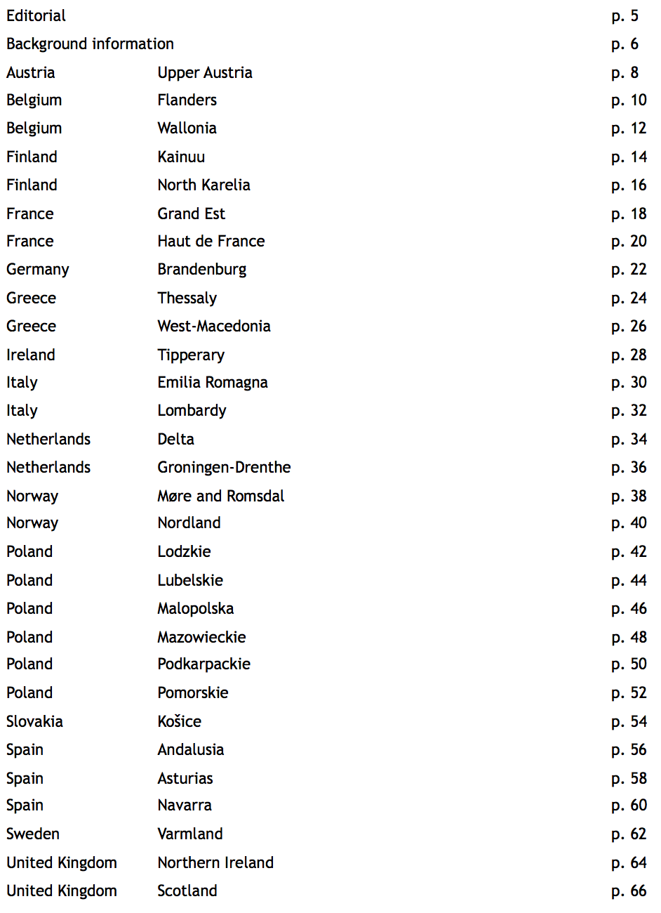
Current content in Europe

Slide 33
Why should YOU join BIC?

Slide 34
BIC Coordinators in submitted vs selected proposals
Success rate of proposals having a BIC Coo : 47.4 %
Success rate of proposals having a non-BIC Coo : 23.8 %
Notes:
Call 2016 submission statistics

Slide 35
BIC members in submitted vs selected proposals
BIC members : 38.1 % success rate in selected proposals
Non-BIC members : 24.8 % success rate in selected proposals
BIC membership in submitted proposals
(participation)
BIC membership in selected proposals
20.1%
27.83%
72.17%
79.9%

Slide 36

How to get involved?
Respond to annual BBI Calls for Proposals Participate in project proposals
Become a member of BIC (annual fee) to actively contribute to the development of the annual BBI Work Plans
Visit http://biconsortium.eu/join-us for more information on becoming a member
BBI Call for Proposals
BIC MEMBERSHIP
Contributing to Work Plan development

Slide 37

Join Us
www.biconsortium.eu
Follow us & like us: @biconsortium

