Slide 1
Irish Bioeconomy Association
All Island Workshop – Bio Based Industries
UCD
Tuesday, June 6th , 2017
Anthony Fitzgerald
Business Development Officer
Tipperary County Council

Slide 2

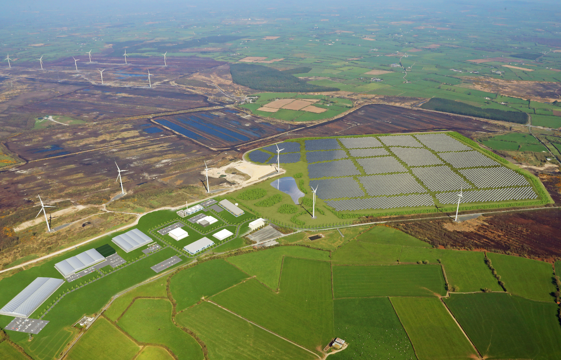
National Bioeconomy Campus

Slide 3
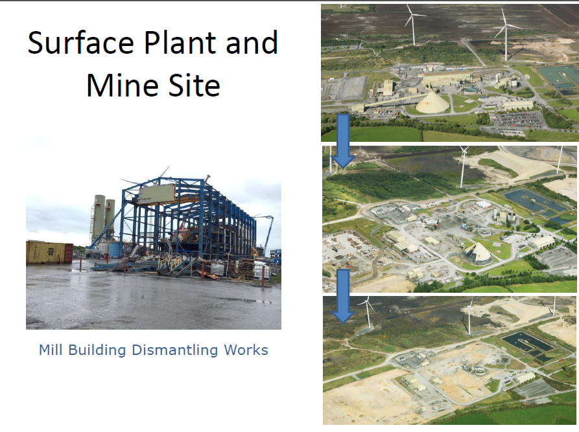

Slide 4
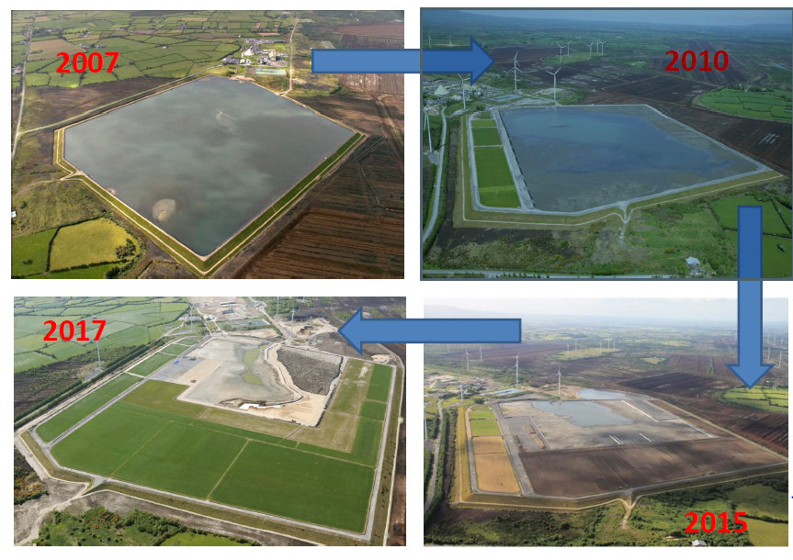

Slide 5
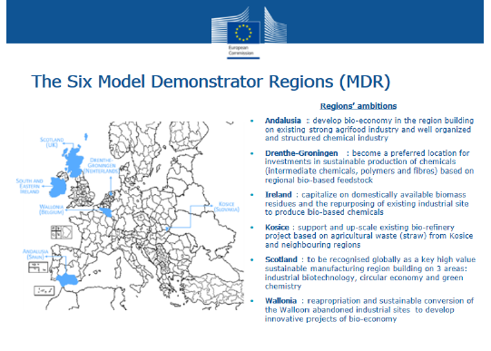

Slide 6
National Bioeconomy Campus
Task force – 2013
Potential projects – 2012 and ongoing.
CMP
  Site evaluation
  Planning application in April 2017
Other industrial projects
  Indigenous Agri Food project
  North American itinerary
  UK based feasibility study
  Four other enquiries

Slide 7
Irish Bioeconomy Association
Established in 2016
REDZ funding
Feasibility study
REDF application to Enterprise Ireland
Centre for applied research, education and training
TRL levels 4 to 6 inclusive
BEACON
Irish Bioeconomy Foundation CLG

Slide 8
National Bioeconomy Campus

Slide 9
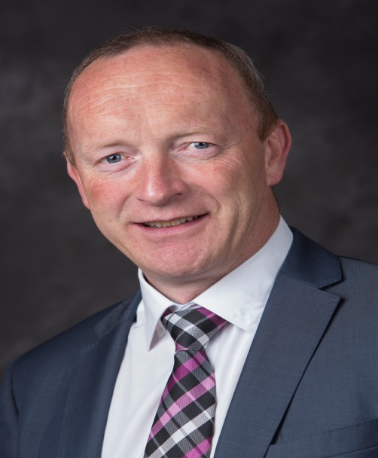
Thank you and Q&A
Contact Details:
anthony.fitzgerald@tipperarycoco.ie
086-6791757

